Slide 1
CES 361
Fundamentals of Software Testing
Session 7

Slide 2
Glitch of the Day
Bank Error in Your Favor
Account Number: 71581555022
User Input: 715815555022
Do you see what the user did?

Slide 3
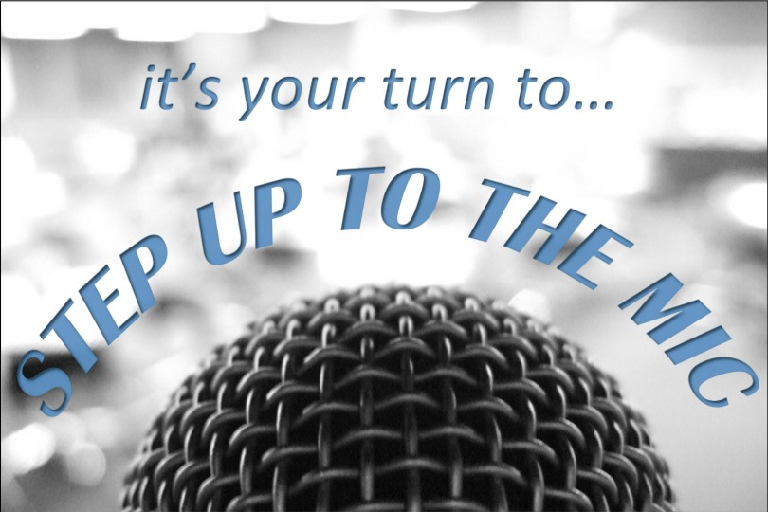



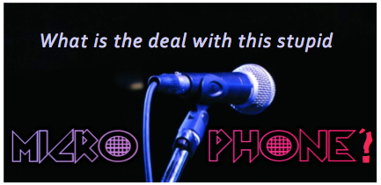

3 Techniques Discussed So Far
Equivalence class testing
Boundary value testing
Orthogonal array testing
    What is the difference between orthogonal
    array testing and pairwise testing?
One more question...

Slide 4
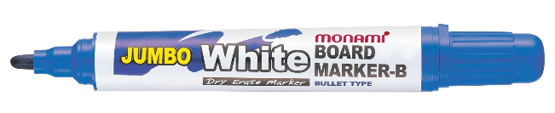
Decision Tables
2 kinds of rows: Conditions & Actions
Conditions go on the TOP.
Actions go on the BOTTOM.

Slide 5
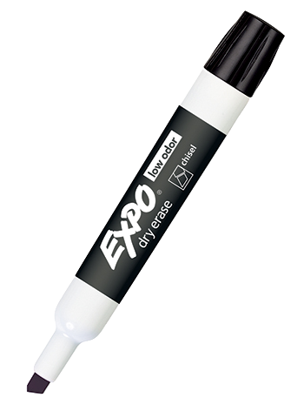

Decision Tables
Book’s example: Triangle Program
Table 7.2 (open to pg. 104 or 118)
4 actions
1 pseudo-action (more of a fact than an “action”)
4 conditions
What is the difference between Tables 7.2 & 7.3?
What is the Rule Count in Table 7.5?

Slide 6
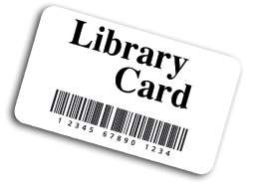
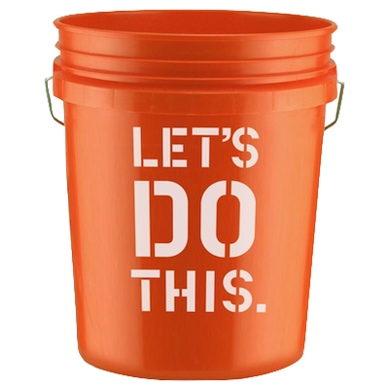
Decision Tables
Book’s example: Triangle Program
Our example: Library Checkout Program
Library Checkout Requirements
The library has three types of materials:
Books, Movies (DVDs), Music (CDs)
2. Patrons with accumulated fines of over $5
may not check out any more materials
3. Patrons under 13 may only check out G-rated DVDs
Patrons under 17 may not check out R-rated DVDs
Patrons under 16 may not check out Explicit CDs
4. Patrons may not check out more than 30 items
at any one time
5. Patrons may not check out Interlibrary Loan
materials from outside the county until they have
been a member in good standing for at least 1 year
Notes:
Age 12: G-Rated DVDs only (no PG13- or R-rated DVDs or Explicit CDs)
Age 13: G- and PG13-Rated DVDs (no R-rated DVDs or Explicit CDs)
Age 16: G- and PG13-Rated DVDs + CDs w/ Parental Advisories (no R-rated DVDs)
Age 17: No restrictions

Slide 7
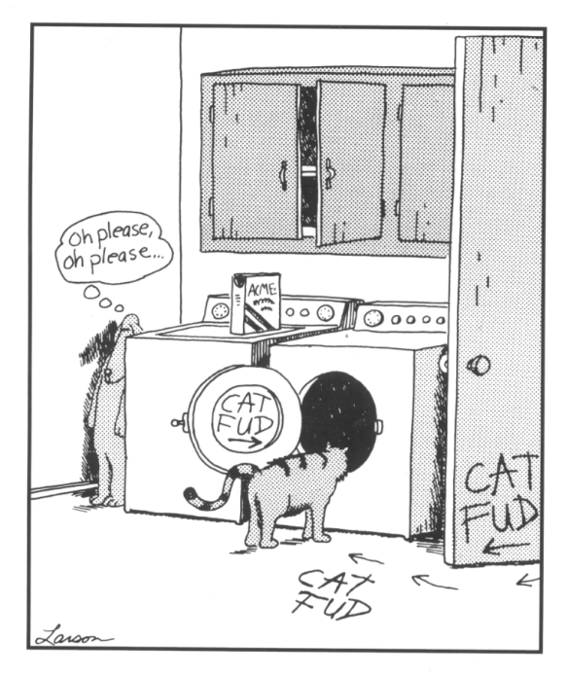
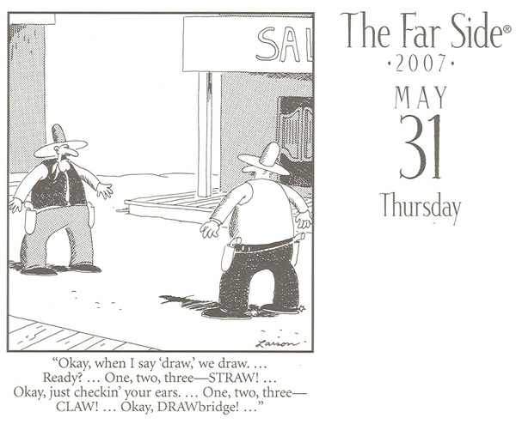
Decision Tables
Don’t expect “instant” results
  Book has 3 tables for triangle program, and
  4 tables for the NextDate function
WHY?

Slide 8
HW 2
Now posted on Pilot – due on Monday

Slide 9
This slide intentionally left blank

